Slide 1
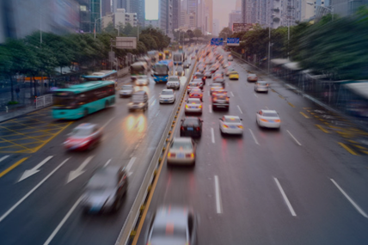
Car Accident severity prediction Applied Data Science capstone Project
Subir Saha

Slide 2
Business Problem
Road traffic accidents cause millions of deaths and injuries every year globally
Road traffic injuries cause significant economic losses - costs most countries 3% GDP
Insights on factors leading to high accident injury risk provide valuable guidance for public traffic polices
Also benefits public individuals for safer road trips
Car accidents are one of the most common issues found across the globe to be severe. Accidents might sometimes be due to our negligence or due to natural reasons or anything. Sometimes, we might be too lazy or negligent to drive costing our lives as well as the others. Whereas sometimes, due to heavy rain or heavy gales etc. we might unknowingly droop into an accident with the other car. Whatever the reason maybe, car accidents not only lead to property damage but cause injuries and sometimes even leading to people's death.
To overcome this cause of the accident we need to do some analysis on the existing accident data so that we can identify what are the factors be the reason of a car accident and how we can get rid of it and take a necessary precaution to avoid it as much as we can.
In this case we are trying to predict a classification model on the basis of Severity Code.

Slide 3
Data Engineering
Example dataset was used with goal to predict accident severity (code1-property, code 2-injury)
Unmatched data and duplicated columns were dropped
Data rows with missing entries were dropped

Slide 4
Feature Selection
10 Features have been selected to build the classification model.
Weather
Collision type
Address type
Road Condition
Light Condition
UnderInfl
PersonCount
Vehcount
Pedcount
Pedcylcount

Slide 5
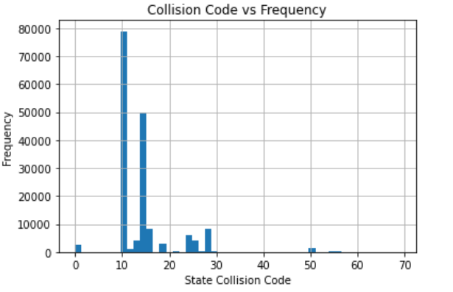
Data Analysis- Collision Type
After that I did a comparative analysis between collision Code and frequency and found that the most accident happened on collision_code=’10’.

Slide 6
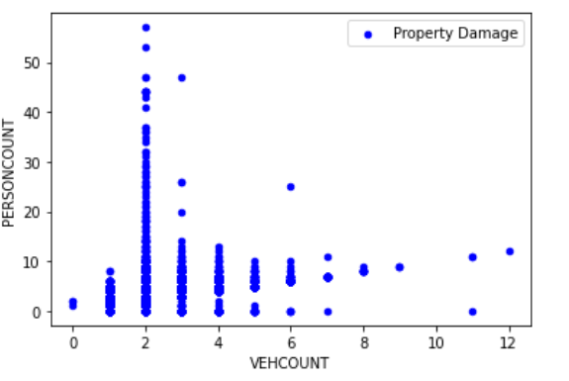
Data Analysis – Property Damage
I started my analysis with the vehcount and personcount for the severitycode=’1’(i.e Property Damage).I derived that most of the belongs to vehcount=’2’ i.e Most property Damage happened when Vehcount=’2’

Slide 7
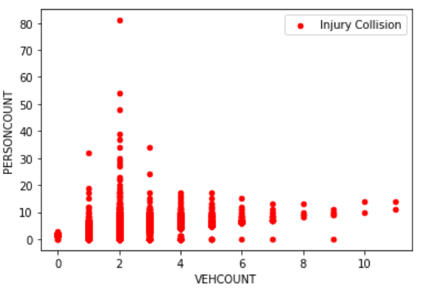
Data Analysis – Injury Collision
When it comes to severitycode=’2’(i.e Major Injury) we can see that in that case the Major Injury happened when accident occurred between 2 vehicles.

Slide 8
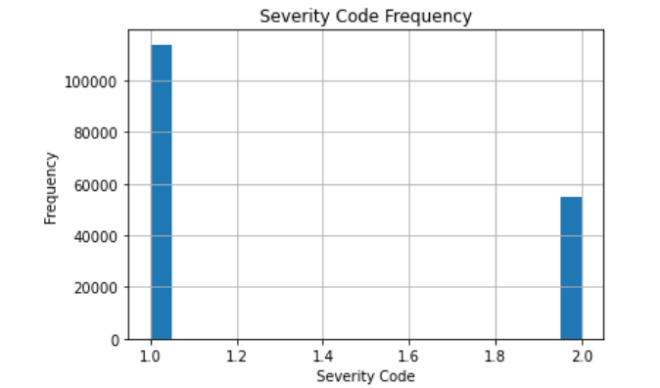
Data Analysis – Severity
After that I wanted to see that what is the count of each accident severity code and found that the major effect on property damage.

Slide 9
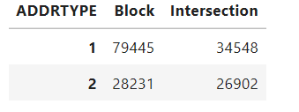
Data Analysis- Address Type
Accidents happen more frequently at block
Accidents at intersection are more likely to cause injury

Slide 10
Data Analysis – Weather Condition
Weather processed with simplified categories, converted to ordinal numbers based on risk.
The left side indicates the accident severity code.We can directly see that the maximum number of accident occurred when the weather was ‘CLEAR’ .

Slide 11
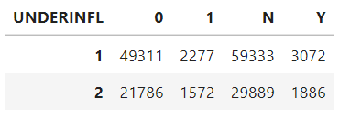
Data Analysis – Driving Behavior
under-influence attributes: missing data entry was interpreted as “N” and converted to binary 0 or 1; all selected for model
We can see that the maximum number of accident happened when underinfl=’N’.

Slide 12
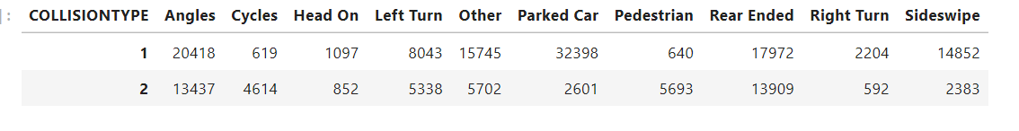
Data Analysis – Collision Type
We can see that the property damage happened mostly due to ‘Parked car’ but major injury happened due to ‘Angles’ and overall responsible is ‘ParKed Car’.

Slide 13
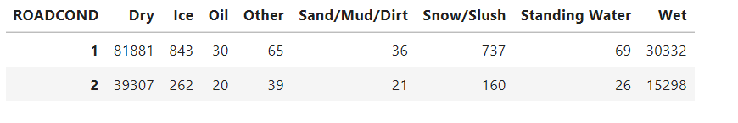
Data Analysis – Road Condition
The most accident occurred when the road was in ;Dry’ Condition.

Slide 14
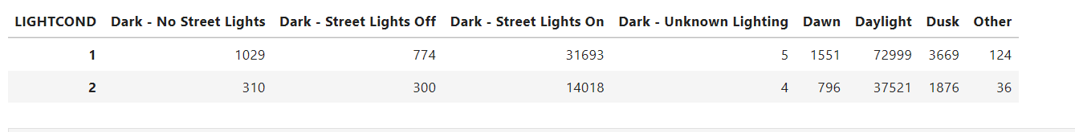
Data Analysis – Light Condition
The maximum number of accident occurred in the daylight.

Slide 15
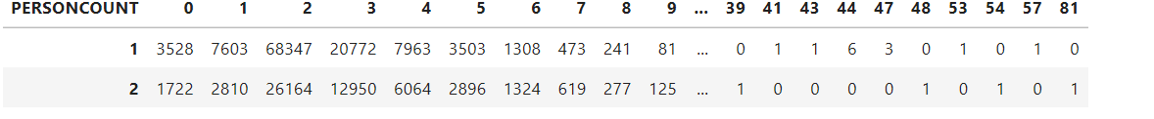
Data Analysis – Person Count
In the all accident the major 2 persons category affected.

Slide 16
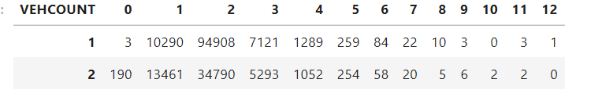
Data Analysis – Vehicle Count
We can see that the majority accident occurs when there is 2 vehicles involved.

Slide 17
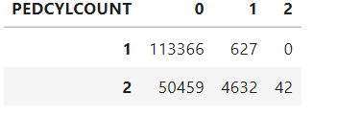
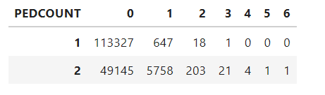
Data Analysis - PedCount
The major accident happens when pedcount=’0’.
The major accident happens when pedcylcount=’0’.
I calculated the correlation between each feature with severity code but I did not get any good correlation ☹.

Slide 18
K Nearest Neighbour Model
10 features were selected for model
I choose KNN classification algorithm and Decision Tree Algorithm to build classification as it gives me better accuracy score.
First i tried with KNN and then Decision Tree.

Slide 19
1st Model & Performance
1st Model(KNN) with all features included.
First I tried with random k-4 and it gives me the accuracy score is given below.
Train set Accuracy: 0.7283871448810678 Test set Accuracy: 0.7108685277976616
After that I tried with generalised K starting with 10 and decreasing and I got the best accuracy on K=8
array([0.65828561, 0.70081723, 0.67832856, 0.71086853, 0.70457528, 0.7124493 , 0.70278573, 0.71414937, 0.70958602])

Slide 20
Result Discussion & Recommendation
Most important features: pedestrians, bicycles, person-count involved in accidents; followed by vehicle count involved and hit-a-parked-car situation
Public traffic polices are recommended with more protection of pedestrians & bicycles on roads like having more marked crosswalks, bike lanes, pedestrian having right of way, more road warning signs for pedestrian and bicycles passing, etc.

Slide 21
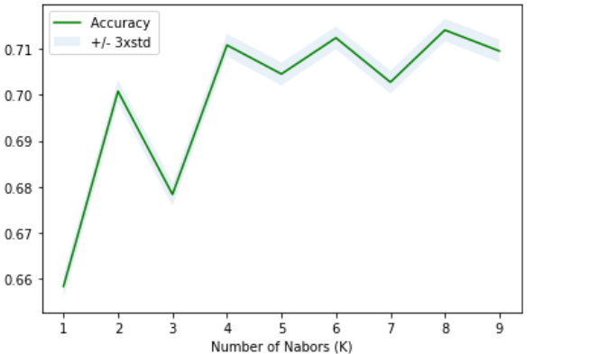
2nd Model & Performance
Here I used Decision Tree Model
DecisionTrees's Accuracy: 0.7240515390121689

Slide 22
Result Discussion & Recommendation
Most importance features: address type, driver under-influence, inattention; followed by speeding, light condition & weather
Intersection is highly susceptible for severe accidents with injuries
Dangerous driving behaviors more likely to cause injuries especially under less favorable driving conditions
Recommend to have better intersection design with increased visibility, more guidance signs; reinforced public education of safe driving, strict punishment measures to prevent dangerous driving behaviors

Slide 23
Conclusion & Future Study
Useful and informative models built to predict accident severity
Value in guiding public traffic polices to focus on important factors to prevent accident injuries
Accuracy of model has room for improvement, more insights could be gained
Collision type be further processed and used in model
Accident address be grouped based on injury occurrence ratio and used in model
Accident trend by dates

